Slide 1

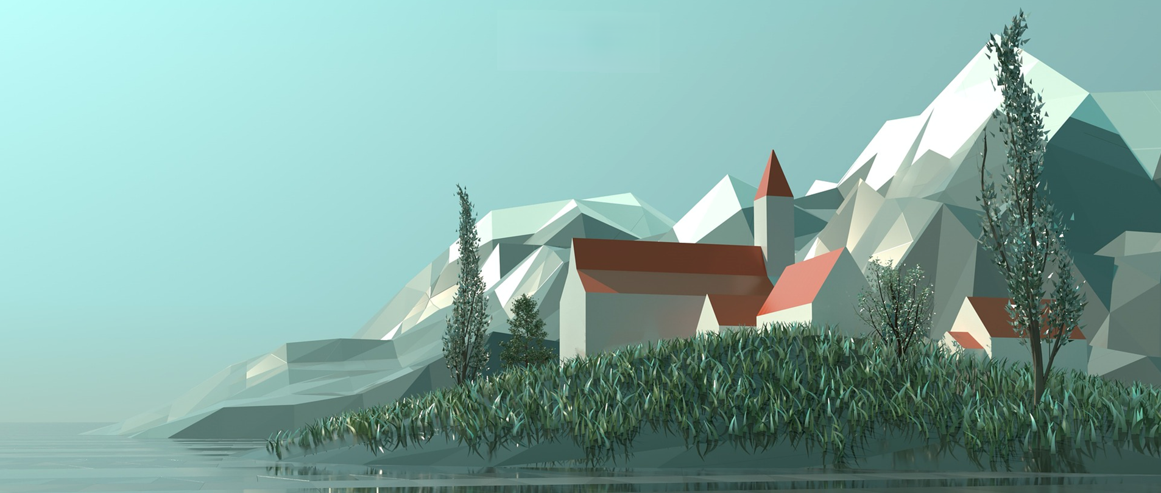

Large-scale scene simulation of games in cold-temperate deciduous coniferous forest area based on UE
Zhiyuan Wang
QM No.190017767
Notes:
Welcome, My name is Zhiyuan Wang. Today, I am going to give you a presentation to introduce my project’s mid-term progress.
First, let me clarify the purpose of the project.

Slide 2
1. The Purpose of the Project
Objectives
Problem Definition
Obtain detailed terrain data to simulate real terrain as closely as possible.
Obtain survey data and build a vegetation cluster model.
Complete the PCG algorithm and add procedural plant assets.
Build the cold temperate 3D game scenes with UE5, including lighting, rendering, shooting and particle effects.
Create a simulation of a frigid zone surface landscape
Highlight the characteristics of the area - flora, climate and topography
Done using PCG algorithm
Done with Unreal Engine
Notes:
We can divide the purpose into two parts: Problem Definition and Objectives. Each contains four parts.
The purpose of my project is to make a virtual simulation scene using PCG technology in UE5.

Slide 3




2. Background
Vegetation Cover
Cold Zone
Forest: Broad-leaved forest Coniferous forest
Shrub and Grassland
Greater Khingan Range
Snow Effect
Procedural Content
Generation
Unreal Engine 5
Material Function
Procedural Content Generation
Weather Function
Tree Generation: PFS
Shrub Generation: LGT
Notes:
About the background, there are 4 main parts.
First, The plants and weather must correspond to the environment. Second, use Procedural Content Generation
For the Tree Generation, I use Procedural Foliage Spawner (PFS)
For the Shrub Generation, I use Landscape Grass Type - LGT.
Last, All implementation methods must be done in UE5.

Slide 4
3. Finished work to date
1
2
Vegetation Model
Material Function
Vegetation: trees and other plants
Trees： Birch, Larch, Black Alder, Spruce
Grass Land: Pine bushes, Big oil awn, Daisy…
Tree Generation: Procedural Foliage Spawner -PFS
Shrub Generation: Landscape Grass Type - LGT.
Planar: generating grass on flat land
Slope: generating cobblestones on gentle slopes
Side: generating the cliff on steep slopes
Foliage Eraser: eliminating grass generated by LGT
Caustics: giving the rain erosion effect to the auto layer
Auto: mixes all the above layers and sets several parameters to adjust the automatic generation effect
3
4
Snow Effect
Scene Optimization
Snow function: controls parameters such as the snowfall curve
Subfunction: needs to be linked to the output node of each material to controlling the color
2D blend: Use WorldAlignedBlend method to blend the white color directly to the surface of the material to create the snow effect.
Set mesh LOD (Levels of Detail)
Set the position and importance of the nodes of the plant asset, determine the resource allocation for object rendering
Set the mesh culling distance (Cull Distance)
By setting Cull Distance, mesh components are automatically culled from the scene after a certain distance from the camera, saving computational performance.
Notes:
Third party is finished work to date
For this part, I will show a demo running on my Computer.
Part1: Vegetation Model
For this part, I create a demo map to show all trees and shrubs that I used
Part2: Material Function
I create a auto material function contains 6 layers.
The Planar layer is responsible for generating grass, which is generated on land with a slope of fewer than 10 degrees.
Then the Slope layer generate the cobblestones on slopes, then the Side layer generating the cliff.
You can see with the landscape changing, the material is automatically generated to cover the surface.
Part3: Snow Effect
The snow effect is a complex blueprint function, this function contains snow function and a subfunction. The snow function controls parameters such as the snowfall curve, and controls the occurrence of the entire snowfall behaviour; The subfunction needs to be linked to the output node of each material(grass material, leaf material, cobblestone material, etc.) to control the colour.
Part 4: Scene Optimization
It mainly has two techs, Levels of Detail and Cull distance. Let me introduce the LOD:
It can be seen that as the proportion of objects on the screen decreases, the number of LOD layers increases, and the number of triangles and vertices decreases rapidly. Scene computing resources are optimized. After adding LOD to the mesh, the FPS of the scene was significantly improved.

Slide 5
4. Problems and Solutions
Problems——
——Solutions
Modify the material blending function so that the snow effect can be added to the material layer.
Create sound effects then add sound effects.
Scene performance optimization: set mesh LOD, set mesh Cull Distance.
The snow material cannot be added to all material layers.
Scene sound effects cannot be added correctly.
The scene FPS is sometimes lower than 30.
Notes:
照着念

Slide 6
5. Further Work
Works:
Improve scene performance optimization.
LOD
Cull Distance
Virtual Texture
2. It is expected to add two scene highlights:
Snow effect - Interactive snow
Snow effect: plants, leaves, ground
Movement leaves traces on snow.
Seasonal effect – Seasonal leaf color
The leaves change color with the seasons
Seasonal system
"Colorful mountain"
Notes:
For further work, there are two key points:
照着念

